Slide 1

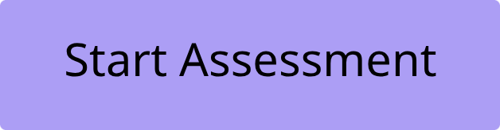
GovTech: Precision Testing for Future Engineers
The first standardized platform for CS Graduates and Government Job Aspirants.

Slide 2


The Government Sector Gap
The Challenge
Government Sector Gap
Computer Science graduates across Pakistan are caught between two worlds—and failing at both.
Abundant learning resources everywhere—yet no way to test mastery.
Absence of a dedicated platform for rigorous CS assessment (OOP, DSA, Networks).
Talented aspirants lack real exam-pattern practice.
Potential remains untapped, careers stalled before they begin.
The paradox: Knowledge without validation = No competitive edge.

Slide 3

Introducing GovTech: The Solution
Redefining Standardized Testing
GovTech delivers a specialized module engine that precisely calibrates assessment questions to align with current industry standards and critical government syllabi.
Object-Oriented Programming (OOP)
Data Structures & Algorithms (DSA)
Deep dive into classes, objects, inheritance, and polymorphism with tailored assessments designed for real-world application.
Rigorous practice on arrays, linked lists, trees, graphs, and complex algorithmic problem-solving scenarios.
Computer Networks
Comprehensive modules covering essential protocols, network architectures, and robust security measures.

Slide 4
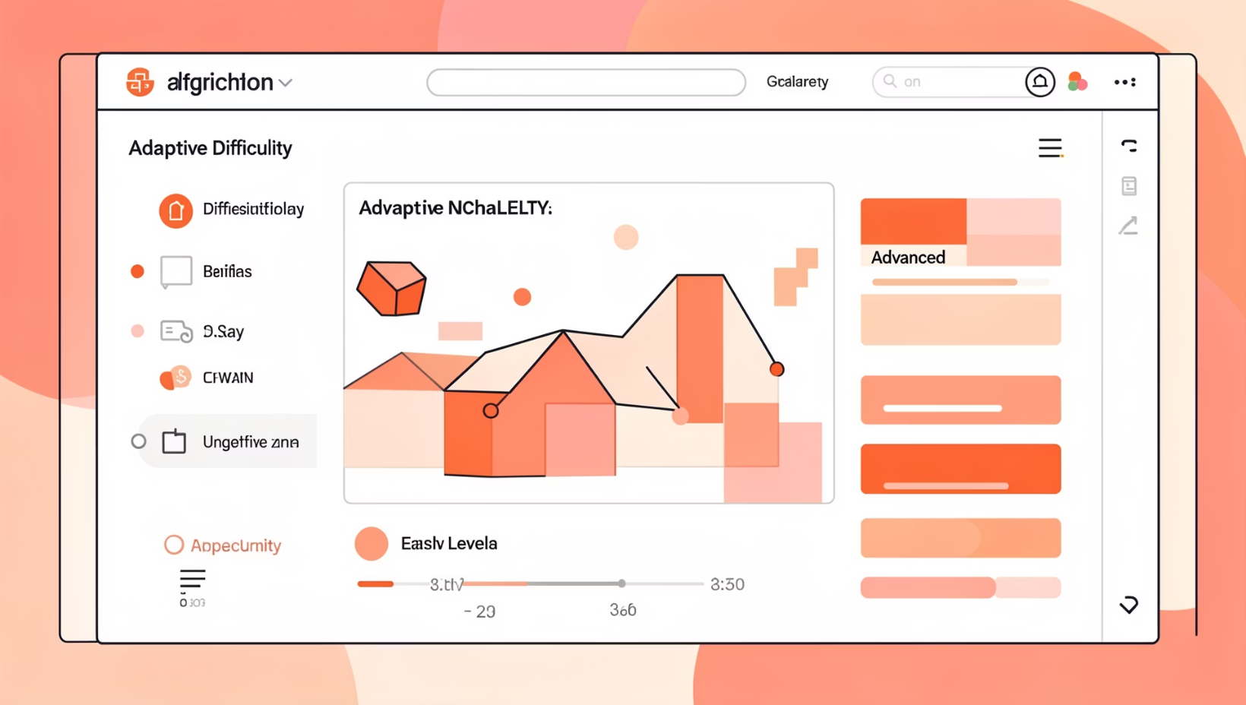
The "Secret Sauce" Tech Stack
01
Adaptive Engine
Real-time scoring with dynamic difficulty adjustment (Easy/Medium/Hard) that mimics actual exam pressure, building confidence progressively.
02
Knowledge Pool
1,000+ meticulously verified questions covering the Big Three: Object-Oriented Programming, Data Structures, and Computer Networks—the foundation of every technical assessment.

Slide 5

The Platform in Action
From Theory to Practice
Let's architect a knowledge base together.

Slide 6
Building the Next Generation of Digital Government
Our vision is to become the standard 'GRE for Computer Science' in Pakistan.
Target Audience
University Students
Fresh Graduates
Public Sector Applicants
Specifically targeting students in Semester 6-8, preparing them for advanced careers.
Equipping recent university graduates with the essential skills for immediate industry impact.
Empowering individuals aspiring for roles in government and public service with critical tech knowledge.
By rigorously preparing these key demographics, we aim to transform Pakistan's tech talent pipeline, fostering innovation and digital leadership across the nation.

Slide 7
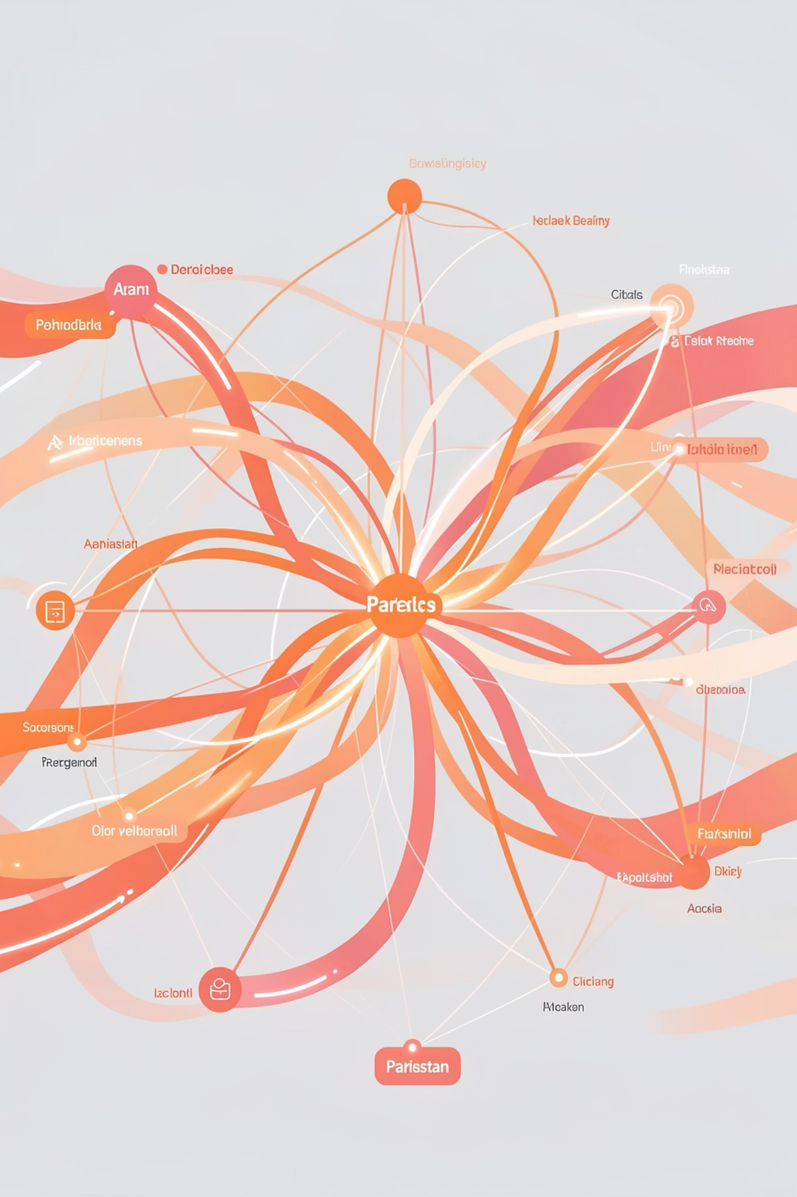
Market Impact & Traction
1.5K
2
3
Questions
Sectors
Core Subjects
Verified CS content library
Private & public pathways
OOP, DS, Networks
Standardizing Pakistan's Tech Talent Pipeline
GovTech is uniquely positioned to bridge the gap between academia and industry while simultaneously serving the public sector. We're creating the first unified platform for Computer Science excellence across both private software engineering roles and competitive National Testing Service exams.
Our approach standardizes preparation, democratizes access to quality content, and builds confidence through adaptive learning—transforming how Pakistan develops its technical workforce.

Slide 8
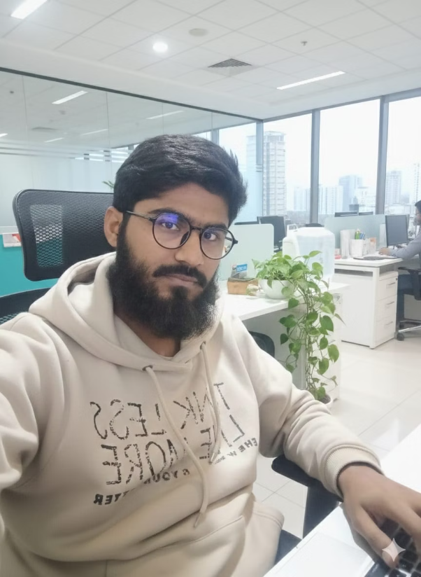

The Team Behind GovTech
Hafiz Umair
Umair Baloch
The Architect
The Data Strategist
Role: Full Stack Developer
Role: Data Engineer
Built the complete end-to-end application, handling the sealess User Interface (UI) and the core Backend API logic that drives the platform.
Engineered the data pipeline—defining sources (acquisition), storage (database optimization), and usage (retrieval logic). Collaborated on the backend to ensure high-speed data delivery.
Join us in transforming Pakistan's technical education landscape. Together, we can bridge gaps, build futures, and create lasting impact.

Slide 9
Questions?
Ready to Transform CS Education?
GovTech: Standardizing Excellence in Computer Science
Get in Touch
Hafiz Umair: umairbwp202@gmail.com
Umair Baloch: umairhafeez951@gmail.com

